Slide 1


Recitation 1
Introduction to Computer Science
Reichman University
Notes:
‹#›

Slide 2




David vs. David
(during the last year)
🤔
But in general:
MSc in CS
audio/nlp domain
TA
Contacts:
david.german@post.runi.ac.il
Q&A forum on Moodle

Slide 3

Administration
Introduction to Computer Science
Reichman University
Recitation 1
Notes:
‹#›

Slide 4
Before We Start
Make sure to be updated in the Moodle Forum
The forum is conducted in English
Read the “From Zero to Code” in Moodle and install course tools on your computer.
Read the “Java Code Style Guidelines” in Moodle carefully.
To get the recitation code click on the LINK. This will follow to every recitation (just replace the 01 with the number you want, 02, 03, 04, etc..)
Practice weekly material with coding problem-sets.
Notes:
‹#›

Slide 5
Overview
Variables & Types of variables
Command line arguments
Casting
Math library
Command line
Git & Github
Errors
Notes:
‹#›

Slide 6

Variables & Types of Variables
Introduction to Computer Science
Reichman University
Recitation 1
Notes:
‹#›

Slide 7
Question 1: Flip Flop
Write a simple Java program that swaps the values of two integer variables without using any operations. or losing data
Example:
if a=5 and b=7 in the start of the program.
by the end of the program a=7, b=5;

Slide 8
Question 1: FlipFlop - Strategy Illustration
Step 1: initial declaration of ‘a’ and ‘b’
Step 2: declaration of ‘temp’ and give it the initial value stored in ‘a’
Step 3: reassign the value of variable ‘a’ to be the value store in variable ‘b’
Step 4: reassign b’s value to be a copy of b
variable name: a
variable original value: 5
variable current value: 7
changed after step: 3
variable name: b
variable original value: 7
variable current value: 5
changed after step: 4
step 3
step 2
step 4
variable name: temp
variable value: 5

Slide 9
Question 1: Flip Flop - Solution
/*
* This program initializes two integers with arbitrary
* values then flips their values. Meaning, the first
* variable will now have the value of the second variable
ֿ* and vice versa.
*/
public class FlipFlop {
public static void main(String[] args){
int a = 5;
int b = 7;
int temp = a;
a = b;
b = temp;
}
}
Notes:
‹#›

Slide 10
Question 1, Expansion 1: Flip Flop
We are going to add System.out.println() lines. In programming it is a very common practice to use printing lines, they have multiple usages among those are the following.
Debugging: One of the primary reasons programmers use print statements is to debug code. Printing the values of variables, flow control indicators, or other significant states can help you trace the execution of a program and identify where a logic error might be occurring.
Documentation and Learning: For beginners, printing out results and intermediary steps can be extremely beneficial in understanding how a piece of code or an algorithm works.
Validation of Assumptions: Developers often make assumptions about the state of the program, the nature of data, or the outcome of a function. Printing can serve as a way to validate or challenge those assumptions.
Data Verification: Before using or after manipulating data, it's often useful to print it out to ensure it meets expectations. For example, after using a function from a library, you might print the data to verify that it was received correctly.
Notes:
הסבר בעפ על Strings ועל Concat

Slide 11
Question 1, Expansion 1: Flip Flop - Solution
// Initializes two arbitrary variable, flips them
// and prints the process
public class FlipFlop {
public static void main(String[] args){
int a = 5;
int b = 7;
System.out.println(“a: “ + a + “, b: “ + b); // added line
System.out.println(“Flipping…”); // added line
int temp = a;
a = b;
b = temp;
System.out.println(“a: ” + a + ”, b: “ + b); // added line
}
}
Notes:
‹#›
סימן החיבור- יש קדימות למחרוזות לכן החיבור הוא חיבור של מחרוזות

Slide 12

Question 1, Expansion 1: Flip Flop - Solution
// Initializes two arbitrary variable, flips them
// and prints the process
public class FlipFlop {
public static void main(String[] args){
int a = 5;
int b = 7;
System.out.println(“a: “ + a + “, b: “ + b);
System.out.println(“Flipping…”);
int temp = a;
a = b;
b = temp;
System.out.println(“a: ” + a + ”, b: “ + b);
}
}
a: 5, b: 7
Flipping...
a: 7, b: 5
Notes:
‹#›
סימן החיבור- יש קדימות למחרוזות לכן החיבור הוא חיבור של מחרוזות

Slide 13

Command Line Arguments
Introduction to Computer Science
Reichman University
Recitation 1
args
Notes:
‹#›

Slide 14
Command Line Arguments - What are they?
A Java program can accept any number of arguments from the command line.
This allows the user to specify variable values before starting a program.
The user enters command-line arguments when running the program and specifies them after the name of the class to be run.
For example, suppose a Java program named Mult reads two command-line integers from the users, multiplies them and prints the solution.
A typical call to Mult will look like this:
% java Mult 9 3
27
% java Mult 1 1
1
Notes:
‹#›

Slide 15
Question 1, Expansion 2: Flip Flop - command line arguments
We are going to add adjust the program to receive command line arguments. In Java programming it is common practice to use command line arguments. using command line argument has multiple advantages among them.
Flexibility: Command line arguments make a program more versatile. Instead of hardcoding certain values, you can specify them at runtime. This means that you can use the same program for different inputs without modifying the code.
Testing & Debugging: While developing, you can use command line arguments to test specific code paths or scenarios without compiling your code again. This can be especially handy when debugging.
Common Convention: Many command-line tools and utilities use command line arguments. If you're developing a tool intended for command line usage, utilizing arguments makes your tool consistent with familiar command line conventions.

Slide 16
Using Command Line Arguments
Command-line arguments can be accessed using args[i] inside main. while replacing i with the place in line of the desired argument, starting from 0.
So, in “% java Mult 9 3”, args[0] is 9 and args[1] is 3.
Every such argument is a String until ‘proven’ otherwise.
The process of allocating an argument to the correct variable type is called parsing.
Every type has a unique parsing technique.
‘int’ – Integer.parseInt(args[0]);
‘double’ – Double.parseDouble(args[0]);
‘boolean’ – Boolean.parseBoolean(args[0]);
Notes:
‹#›
דוגמה- כשפותחים מסמך word

Slide 17
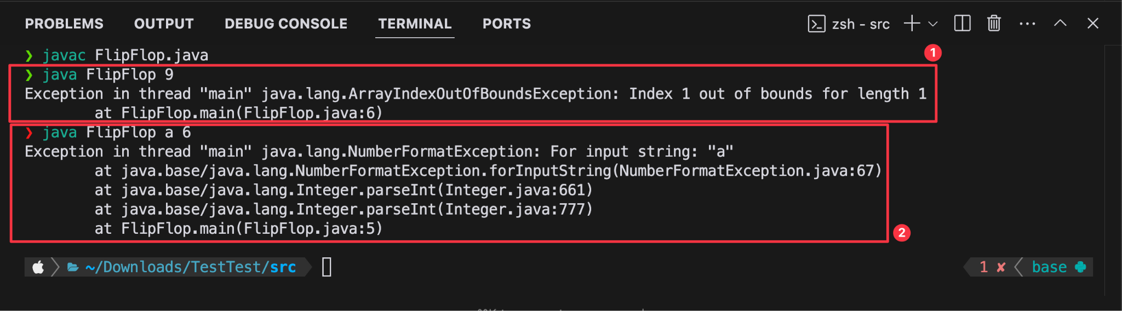
Using Command Line Arguments - Warnings
Two things to look out for:
The user needs to give as many arguments as the program expects to get.
The arguments’ type need to match the types the program expects to receive.
Failing to meet the program’s ‘expectations’ can result in errors.
Notes:
איזה סוג שגיאה זאת? מדוע?

Slide 18
Question 1, Expansion 2: Flip Flop - Solution
// Reads two integers from the user, flips them
// and prints the process
public class FlipFlop {
public static void main(String[] args){
int a = Integer.parseInt(args[0]); //adjusted line
int b = Integer.parseInt(args[1]); //adjusted line
System.out.println(“a: ” + a + ”, b: “ + b);
System.out.println(“Flipping…”);
int temp = a;
a = b;
b = temp;
System.out.println(“a: ” + a + ”, b: “ + b);
}
}
Notes:
‹#›

Slide 19
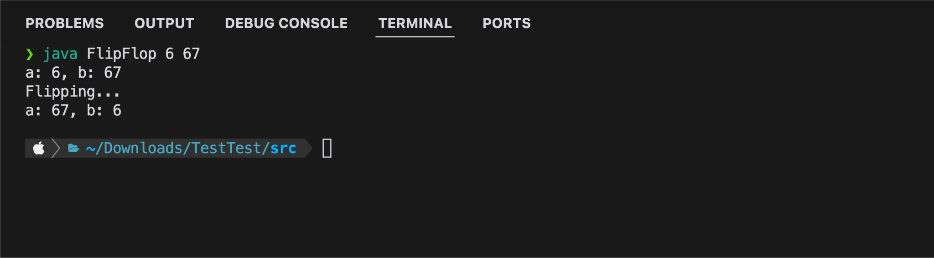
Question 1, Expansion 2: Flip Flop - Solution
//Reads two integers from the user and flips them, //prints the process
public class FlipFlop {
public static void main(String[] args){
int a = Integer.parseInt(args[0]);
int b = Integer.parseInt(args[1]);
System.out.println(“a: ” + a + ”, b: “ + b);
System.out.println(“Flipping…”);
int temp = a;
a = b;
b = temp;
System.out.println(“a: ” + a + ”, b: “ + b);
}
}
Notes:
‹#›

Slide 20

Type Conversion - Basics
Introduction to Computer Science
Reichman University
Recitation 1
double
int
Notes:
‹#›
הסבר בע״פ על המרת טיפוסים.

Slide 21
Type Conversion – Examples
// i is 0
// d is 0.0
// d is 0.5
//cannot convert
//d is 0.5
//d is 0.5
//d is 0.0
int i = 2 / 4 ;
double d = 2 / 4;
double d = 2 / 4.0;
int i = (double) 2 / 4 ;
double d = ((double)2) / 4;
double d = (double) 2 / 4;
double d = (double) (2 / 4);
Notes:
‹#›
שוב איזה שגיאה זאת? זמן ריצה קומפילציה?

Slide 22
Question 2 – Type Conversion
As we know when we cast from double to int the value always rounded down, in some cases it would be wise to round to the nearest integer. bigger than 0.5 will rounded up.
Constraint: for the following question you may not allow to use the Math.round(); and conditions.
Design a program which does the following:
rounds up if reminder is bigger than 0.5, otherwise round down
Notes:
‹#›
שאלת צד 2 (להבין את הנושא של המרת טיפוסים ולעשות חיבור לנושא של ספריית Math)

Slide 23
Question 2 - Solution
public class Rounding {
public static void main(String[] args) {
double value = Double.parseDouble(args[0]);
int rounded = (int) (value + 0.5);
System.out.println("Rounded value of " + value + " is: " + rounded);
}
}

Slide 24

Math Library
Introduction to Computer Science
Reichman University
Recitation 1
Notes:
‹#›

Slide 25
Math
The Math library supports a great variety of mathematical operations.
For complete information and documentation visit the Java Math API at http://docs.oracle.com/javase/8/docs/api/java/lang/Math.html
Notes:
‹#›
השארתי בשביל הlink לAPI .

Slide 26
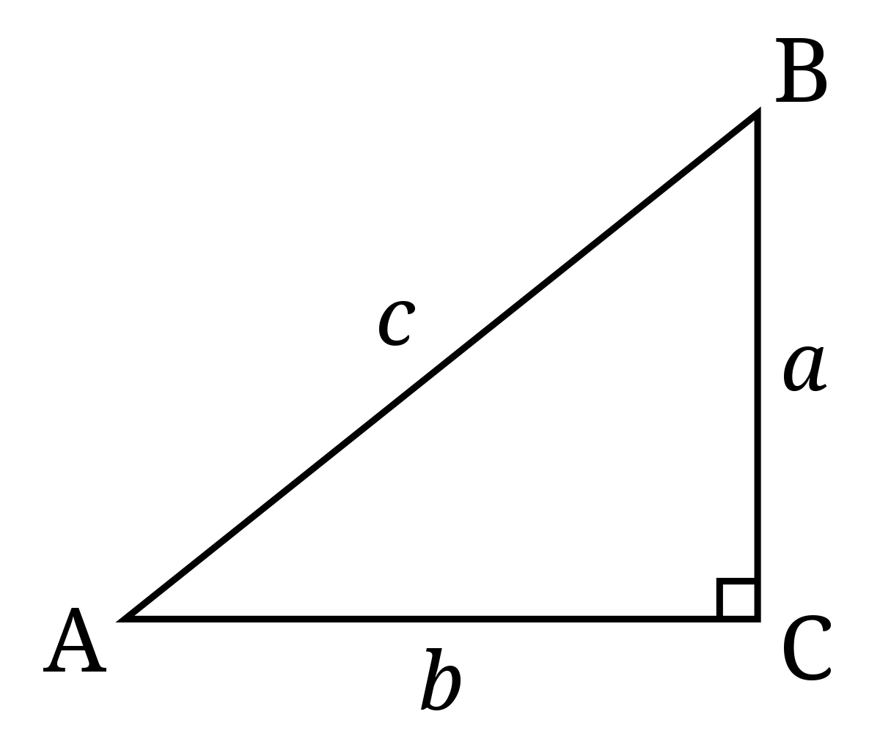
Question 3 – Math
Design a program which does the following:
Receives a couple of ints from the user.
You may assume positive the input is Positive
Calculates the length of the hypotenuse in a right triangle assuming both ints are the other sides.
Returns the calculated hypotenuse value.
Reminder: a^2 + b^2 = c^2
Notes:
‹#›

Slide 27
Question 3 - Solution
public class PythagoreanTheorem {
public static void main(String[] args){
int a = Integer.parseInt(args[0]);
int b = Integer.parseInt(args[1]);
int aSquared = (int) Math.pow(a, 2);
int bSquared = (int) Math.pow(b, 2);
int cSquared = aSquared + bSquared;
double c = Math.sqrt(cSquared);
System.out.println("c : = " + c);
}
}
Notes:
‹#›

Slide 28
Question 4 – Math
Design a program which does the following:
Receives a single of int from the user.
if negative turn into positive (dont need if)
the value represent the radius of a some circle (π * radius^2)
The program prints the area of a circle with the radius.
public class CircleArea {
public static void main(String[] args){
// Your code here
}
}
Notes:
‹#›
Circle will have 3-5 minutes for students to solve

Slide 29
Question 4 - Solution
public class CircleArea {
public static void main(String[] args){
int input = Integer.parseInt(args[0]);
int radius = Math.abs(input);
double area = Math.PI * Math.pow(radius, 2);
System.out.println("Radius: "+radius +" , Area: " + area);
}
}
Notes:
‹#›

Slide 30

Question 5 - Dice Roll
Many board games have an element of dice roll. a fair 6-sided dice have the numbers between 1 and 6 (included).
Design a Java program that simulates the roll of a six-sided dice.
when executed, the program should generate a random number between 1 and 6 (inclusive) to represent the outcome of a dice roll. Display the result to the user.
Ensure that each number between 1 and 6 has an equal chance (as possible) of being rolled (AKA fair 6-sided dice). You may use Math library freely in the solution.
That sounds like a complicated problem, how to approach the problem?
Notes:
‹#›

Slide 31
Question 5 - Strategy
First, identify what can be used.
We can use Math.random(), to generate a random number.
Second, identify if the problem is solved, and if not what are the problems we need to tackle solve?
No, the function Math.random(), returns a double between 0 and 1(not included). so we have 2 problems:
The range of the roll is not correct (which breaks into 3 smaller problems)
Minimum value of range is not correct (0 instead of 1)
Maximum value of range is not correct (1 instead of 6)
Maximum value of range is not included (should be included)
The type of value (double instead of int)

Slide 32
Question 5 - Strategy
Now we solve those problems:
For both maximum problems, we can multiply the result by the difference of range + 1. Example: 0.5 * 6 = 3, 0.66667 * 6 = 4 etc.. Expand the range
For the minimum value, we can add 1 to the result. if rolled a 0.1 which will turn to 0, after adding 1. Move the range
As for the type of value and the maximum value not included, we can cast the double into int. Cast to int
Last, lets combine the solutions in the right order.
expand range
move range
cast to int
double in range between
0 and 1.
1 not included
double in range between
0 and 6.
6 not included
double in range between
1 and 7.
7 not included
int in range between
1 and 6.
Notes:
לציין כי, לפעמים דבר אחד לא מספיק לפתור את הבעיה.
לבצע דיון למה ההכפלה ראשונה. בפתרון
לבצע דיון מה קורה בcasting. ולמה זה לא ראשון

Slide 33
Question 5 - Solution - step by step
Print a real number between 0 and 1 (Phase 1)
System.out.println(Math.random())
Print a real number between 0 and 6 (Phase 2)
System.out.println(Math.random() * 6)
Print a real number between 1 and 7 (Phase 3)
System.out.println(Math.random() * 6) + 1
Print an integer between 1 and 6 (Phase 4)
System.out.println((int)((Math.random() * 6) + 1))
Notes:
‹#›
לשאול מה היה קורה בלי הסוגריים? אם מישהו מציע את זה זה עוד יותר טוב ☺

Slide 34
Question 5 - Solution
public class DiceRoll {
public static void main(String[] args){
System.out.println((int) ((Math.random() * 6) + 1));
}
}
Notes:
‹#›
לשאול מה היה קורה בלי הסוגריים? אם מישהו מציע את זה זה עוד יותר טוב ☺

Slide 35
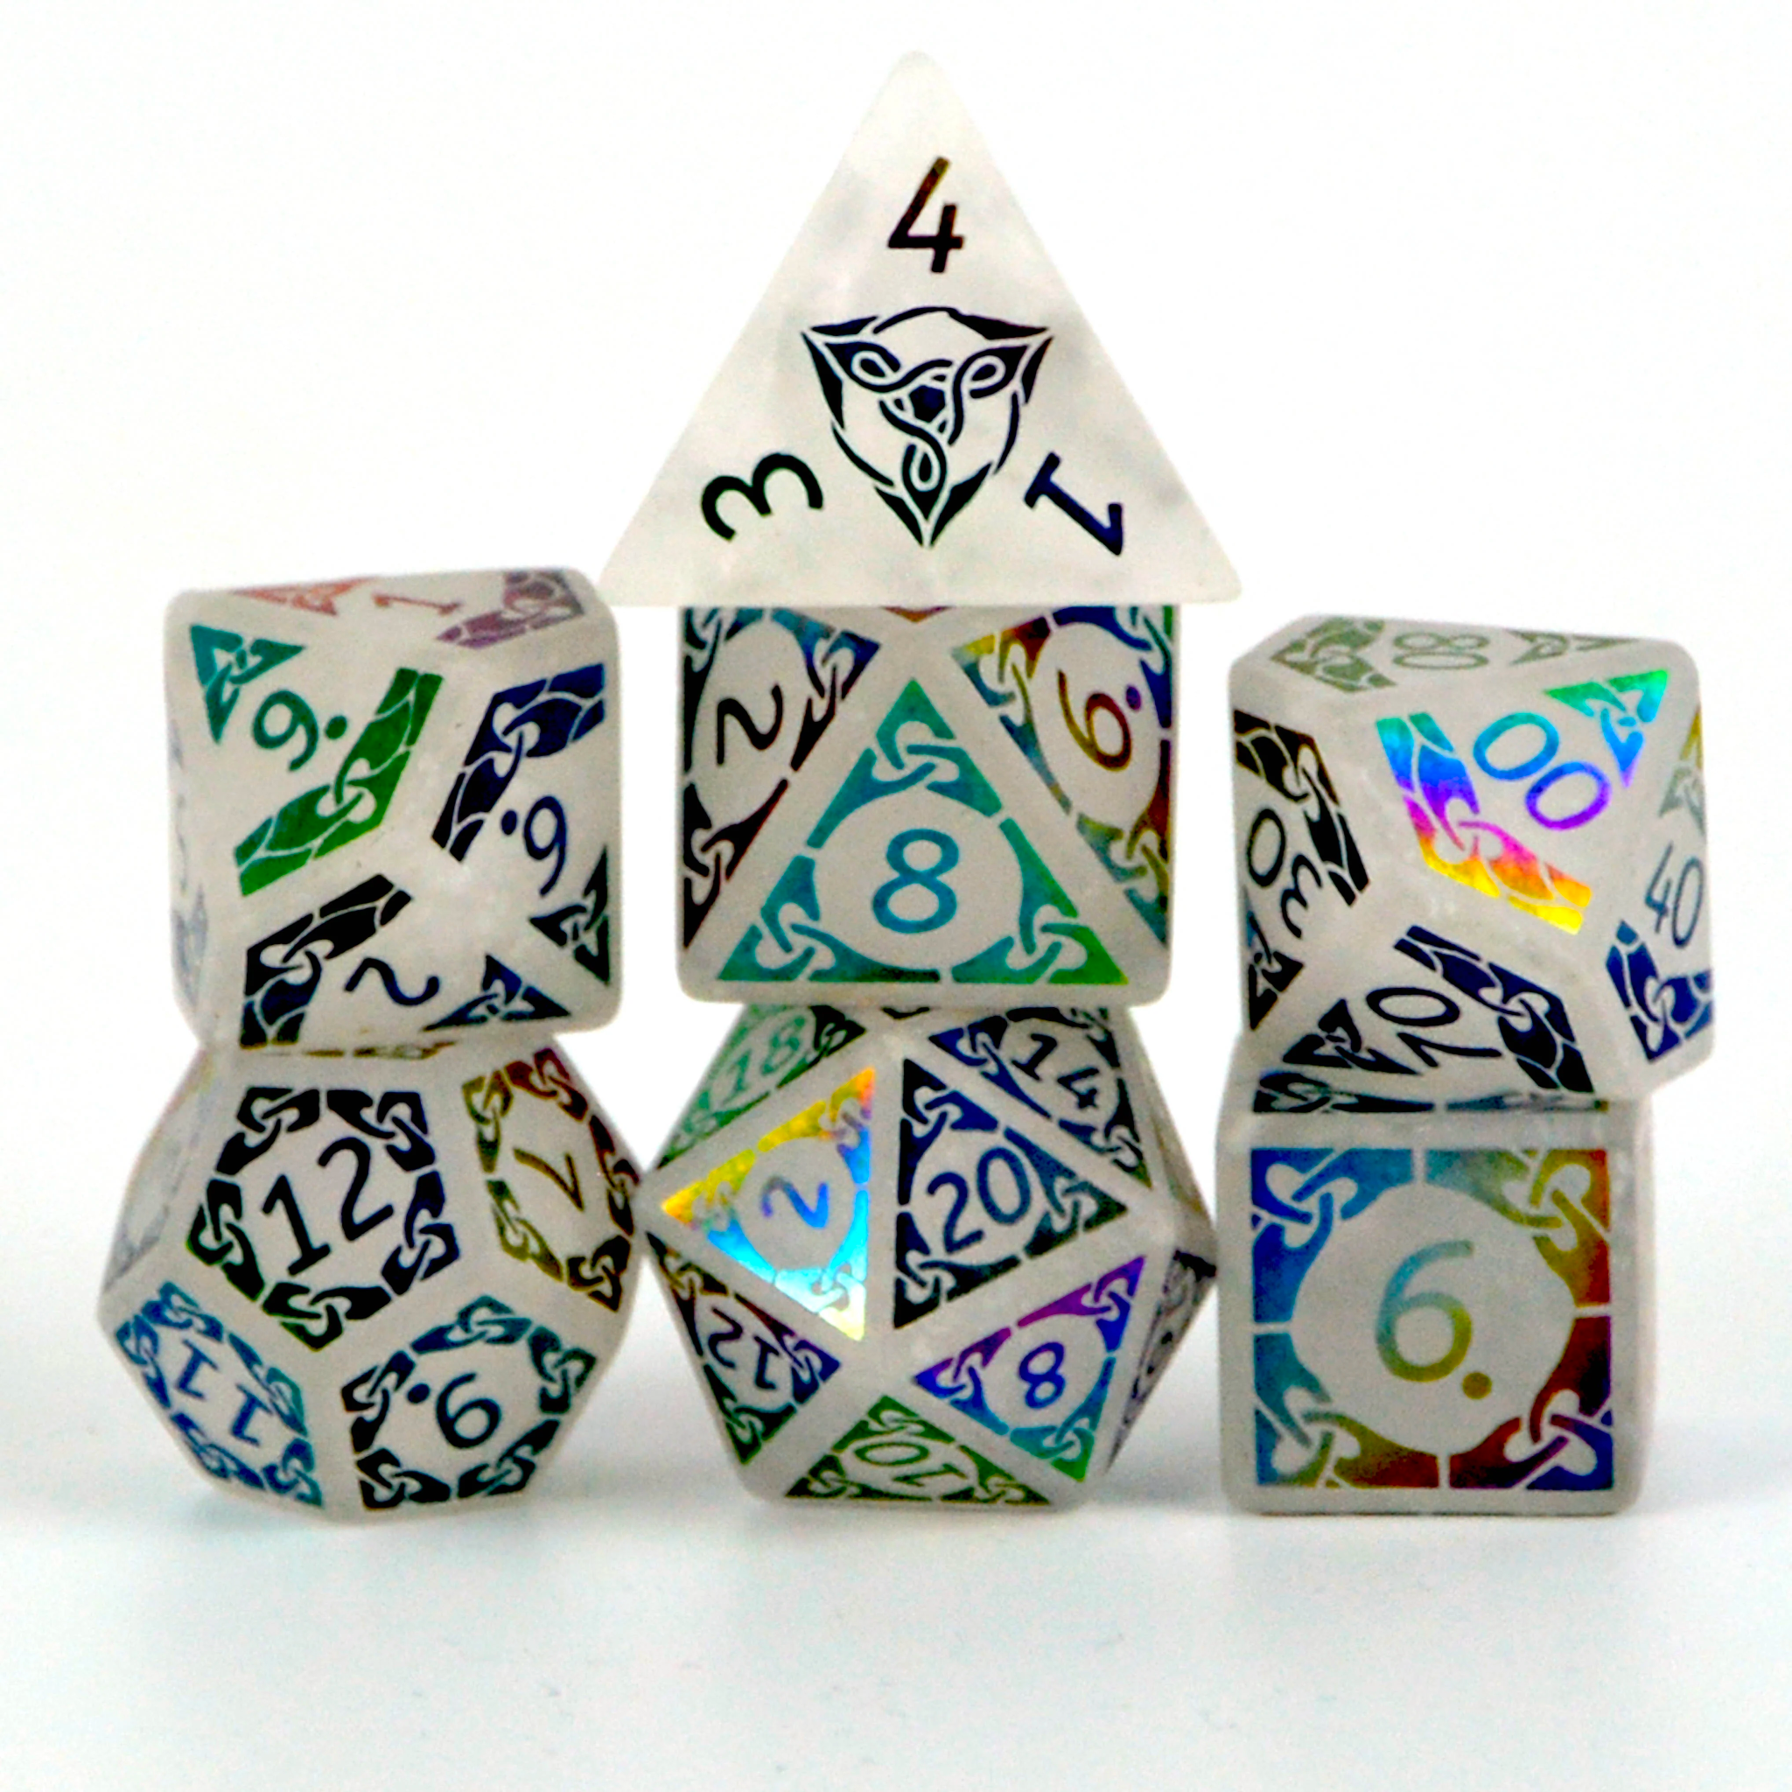
Question 5, Expansion 1 – Non 6-Sided DiceRoll
Some games have other 6 options for a randomness:
If I were to shuffle a deck of cards, I have 52 options to draw a given card. (13 cards for each suit).
In D&D, there are dice with various number of sides (for example: 4 sided dice, 8 sided dice, 10 sided dice, 20 sided dice).
Design a Java program that simulates the roll of an N-sided dice.
When executed, the program receives a positive int named “max” which represent N (such that N > 1) from the user.
Then the program should generate a random number between 1 and N (inclusive) to represent the outcome of a dice roll. Display the result to the user.
Ensure that each number between 1 and N has an equal chance (as possible) of being rolled (AKA fair N-sided dice). You may use Math library freely in the solution.
Notes:
‹#›

Slide 36
Question 5, Expansion 1 - Solution
public class DiceRoll {
public static void main(String[] args){
int max = Integer.parseInt(args[0]);
System.out.println((int) ((Math.random() * max) + 1));
}
}
Notes:
‹#›
לשאול מה היה קורה בלי הסוגריים? אם מישהו מציע את זה זה עוד יותר טוב ☺

Slide 37
Question 5, Expansion 2 - Random range
Some games have other may include negative numbers or numbers which are strictly bigger than 1.
If I was to ask someone to pick a number between -10 and 10.
If I was to ask someone to pick a number between 4 and 16.
Design a Java program that simulates the pick of an int number in range [M,N]. (both M and N are included)
When executed, the program receives a couple of int value named “max” and “min” which represent N,M, respectively from the user.
Then the program should generate a random number between M and N (inclusive) to represent the outcome of a number pick. Display the result to the user.
Ensure that each number between M and N has an equal chance (as possible) of being rolled (AKA fair odds). You may use Math library freely in the solution.
Notes:
‹#›

Slide 38

Question 5, Expansion 2 - Solution
public class DiceRoll {
public static void main(String[] args){
int max = Integer.parseInt(args[0]);
int min = Integer.parseInt(args[1]);
System.out.println((int) ((Math.random() *(max - min + 1)) + min));
}
}
Generalize the random in range formula (both work)
(int)( Math.random()*(max - min + 1) ) + min
(int)( Math.random()*(max - min + 1) + min )
Notes:
‹#›
להסביר את ה1+ , שיכיל את המספר המקסימאלי

Slide 39
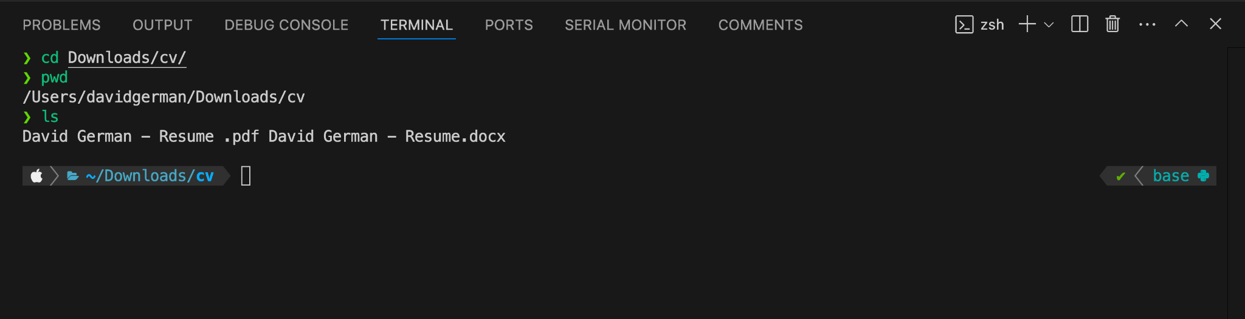
Command line / Terminal
Introduction to Computer Science
Reichman University
Recitation 1
Notes:
‹#›
משתנים- נותן אפשרות לשמור בזיכרון, מאפשר לנו לעשות דברים מגניבים יותר ומתוחכמים יותר מאשר חישוב מקומי והדפסות ☺

Slide 40
Command line - Commands (Java related)
“javac” is a command which receives an input a java file (file with .java extension and must be specified both name and extension) , the command compiles that java file and creates a .class file.
Assume I want to compile the file: MyCode.java
“javac MyCode.java”
“java” is a command which receives an input a compiled java class (class file which shouldn’t be specified) and runs that class.
Assume I want to run the class: MyCode
“java MyCode”
Note: it must have a “main” to run
If there are usages of args in code they must come after the name of the class in order with a single space between them.

Slide 41

Git & Github
Introduction to Computer Science
Reichman University
Recitation 1
Notes:
‹#›
משתנים- נותן אפשרות לשמור בזיכרון, מאפשר לנו לעשות דברים מגניבים יותר ומתוחכמים יותר מאשר חישוב מקומי והדפסות ☺

Slide 42
Git & Github
Git
A tool (software) that helps developers keep track on their code. (It has more purposes but for now that what you need to know)
Key Terms:
Repository - (or Repo) is a project or folder Git watches
commit - is the current saved version.
GitHub
This is a website where people store their Git-tracked projects so others can see them.
It provides a visual interface and hosting for Git repositories.
Key Terms:
Repository (same as Git, but on GitHub's website),
fork\clone (copying someone else's project to your account).
Imagine Git as a diary you write in. Every day (commit), you note what you did. Now, if you wanted to share your diary with the world or collaborate with others, you’d put it in a library (GitHub). If someone likes your story, they borrow it(fork\clone).

Slide 43
Git - Commands
git init
What it does: Initializes a new Git repository and starts tracking an existing directory. It adds a hidden subfolder within the existing directory that houses the internal data structure required for version control.
Example:
Navigate to the desired directory using the terminal or command prompt.
Run “git init”. This will convert that directory into a Git repository.
​​git clone
What it does: Copies a Git repository from a remote source (like GitHub) to your local computer.
Example:
git clone https://github.com/user/repo.git - will create a folder named repo on your local machine with all the repository's files and Git history.
git add
What it does: Stages changes you've made to files for a commit. It's like preparing items you want to pack into a box.
Example:
git add myfile.txt stages changes in myfile.txt.
git add . stages changes in all files in the current directory and its subdirectories.

Slide 44
Git - Commands
git commit
What it does: Saves the staged changes with a descriptive message, creating a new point in your repository's history. Think of it as sealing the box and labeling it with a note about its contents.
Example:
‘git commit -m "Fixed a bug in myfile.txt" ‘ commits the staged changes with a message indicating a bug was fixed.
git push
What it does: Sends your committed changes to a remote repository (like the one on GitHub). It's like shipping your sealed box to a storage facility for everyone to see or access.
Example:
“git push origin master” or “git push origin main” pushes your commits to the master or main version of the remote repository called origin.

Slide 45
Git ignore
Git Ignore (.gitignore)
The .gitignore file is a special file used by Git to determine which files and directories to ignore, before you make a commit.
Why is it used?
To prevent sensitive information, like configuration details or API keys, from being added to the repository.
To exclude automatically generated files, like build artifacts, logs, or compiled binaries, which don't need to be in version control.
To ensure unwanted files, like OS-specific files or cache files from various tools, don't clutter the repository.

Slide 46
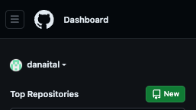
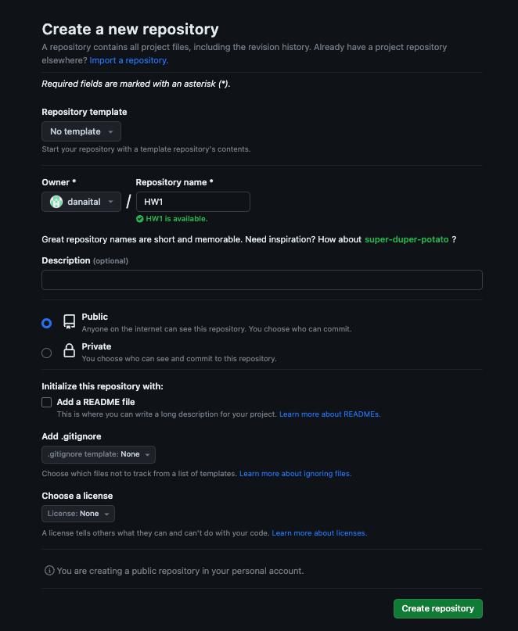
Link local Repo with github repo
Sign to github & configure github and git on your pc
create the folder you want to work with
then open terminal and git init then “git add .” with at least one file then git commit -m “initial commit” (convention)
then on GitHub click new (top left corner) an
Name it & create repo (bottom right corner)

Slide 47
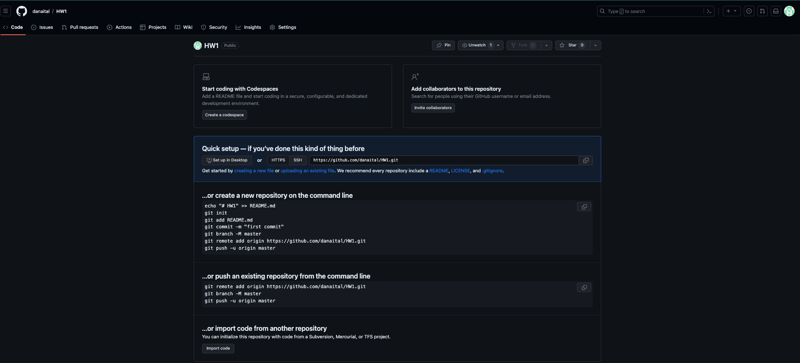
Link local Repo with github repo
copy and paste the second option into the terminal of git repo we started with.

Slide 48
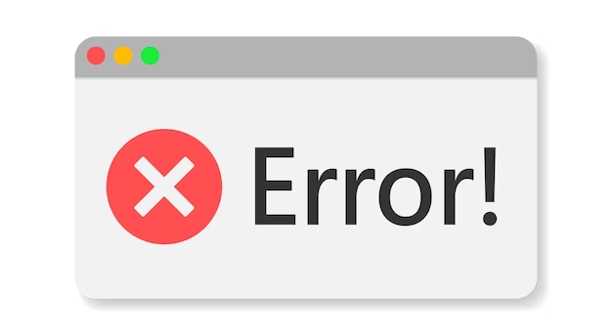
Errors
Introduction to Computer Science
Reichman University
Recitation 1
Notes:
‹#›
משתנים- נותן אפשרות לשמור בזיכרון, מאפשר לנו לעשות דברים מגניבים יותר ומתוחכמים יותר מאשר חישוב מקומי והדפסות ☺

Slide 49
Errors - identify & handle
All basic types of errors can be divided to 3 main types of errors:
Compiler Errors
Runtime Errors
Logical Errors
Note: that there are more types but in this stage the probability you will see one of them is low assuming that safe landing was successful
Tip: don’t get frustrated, sometimes moving a step back is moving 2 steps forward.
Tip: if you get frustrated, sometimes clear your mind can solve it.

Slide 50
Errors - Compiler Errors
This error is caused when you are compiling your code. (javac command)
Those kind of errors are usually minor and mean that somewhere in your code there is something which doesn’t match java guidelines.
In the terms of semantics inside your file there is an error
a syntax error detected by the compiler, example : “reached the ending without parsing” which mean you forgot a “}” somewhere in your code or “‘;’ expected’ which means you forgot a ‘;’ inside your code.
Solution: find what is the error, and where it occurred, then fix it.
Note: Sometimes it is specifying the exact location.
In the terms of logical errors there are multiple options
a mismatch of the declared type variable and given value (when automatic casting isn’t applied (example: int num = “1”; )
Solution: Explicit cast or parse the value.
get a value of a variable which doesn’t have initial value (int n; int m = n;)
Solution: try and always give initial values.
Note: there are languages which allow it (JS for example) but java doesn’t.
Note: there are more

Slide 51
Errors - Runtime Errors
This kind of errors occur once you are running your code. This error can appear once you compiled your file successfully.
Some of those are also called ‘Exceptions’. (This topic will be discussed later in the course).
The nature of the errors are more difficult to solve.

Slide 52
Errors - Runtime Error (Command line arguments)
Command line arguments are entered upon run call. some errors can be similar to the logical errors of in Compiler Errors, and if they were compiled in the code manually it would’ve been Compiler Error.
example:
int s = Integer.parseInt(args[0]);
s = s + 1;
java Examp
The file compiled successfully but the input given wasn’t defined it causes an error if it were:
int s ;
s = s + 1;
solution: first work with literals declared in the code, then after you solved and tested extensively, shift the literals to command line arguments. once you worked carefully with them. then test with command line arguments.

Slide 53

Errors - Runtime Error (Other)
In the terms of logical errors :
Arithmetic error (example : 1/0)
call a negative index in string
Note: some languages allow it like Python. Java doesn’t
call an index which exceed the length of the string
Note: some languages allow it like JS. Java doesn’t
Try to parse a string which represent a non number into a number.
Note: there are many more.
Note: There is one specifically which means you have a logical error.. its name? StackOverFlow.
The solution for all these Runtime errors are the same, you must go and debug your code.
The error usually points you toward the “chain” of lines it crashed, you will see a lot of things you didn’t wrote but usually near the bottom you will find the part of your code, go from there.

Slide 54
Errors - Logical errors
These kind of errors occur are the most difficult to detect, since your program is compiling successfully and seems to be running smoothly but something is still not right. and that is what you intended to do.
How to find them? Test your code. Try many cases and edge cases (cases with high likelihood to fail). know your code inside and out and be sure that you know what is the expected output and see that your actual output is matching.
there are two main types:
Your program doesn’t stop running (solution: ctrl+c in windows, command+c in mac)
Your program stop running
Either way after each you should see what causes the faulty output and change it in a way which
doesn’t change the output of previously checked code and solve the new test case. try to generalize the program to solve as many cases as possible.

Slide 55

VS Code
‹#›

Slide 56
VS (Visual Studio) Code
VS code is a free Integrated Development Environment (IDE) for many programming languages, including JAVA.
Provides many features to support and ease the programming process such as: Syntax highlighting, and Intelligent code completion.
‹#›

Slide 57
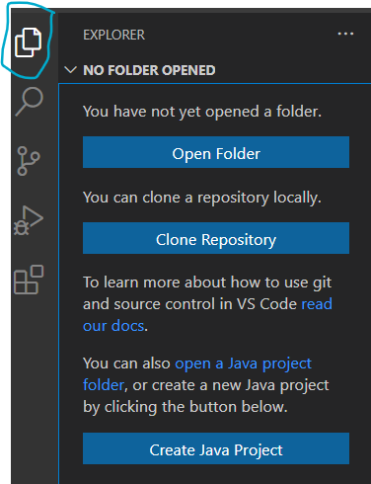
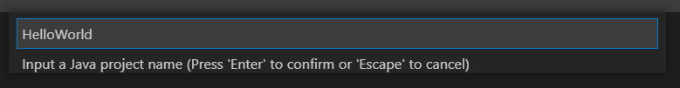
VS Code – Writing your first program
The Java programs are written and maintained in an environment called “Java Project” (similar to the notion of a folder)
Create a new project:
Click the EXPLORER icon (marked here 🡪)
Click “Create Java project”
Choose “no build tools”
Choose your preferred project location (e.g. Intro2CS folder)
Name your project (e.g. HelloWorld)
‹#›

Slide 58
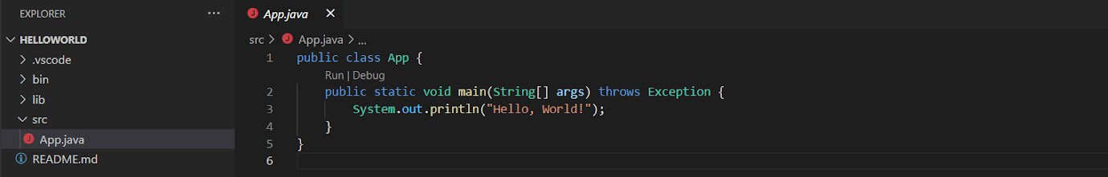
VS Code – Writing your first program
Your project will now open
Your code will be stored under the “src” folder, with a default class called App.java
‹#›

Slide 59
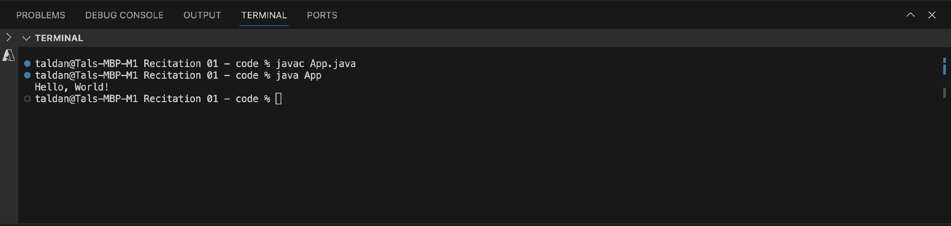
VS Code – running a program
This is what you will see for the HelloWorld code from the previous slide:
This TERMINAL window (yellow) is similar to the terminal/cmd shell used before
The run button replaces the compilation and execution loop
PROBLEMS tab displays compilation and runtime errors (blue)
‹#›

Slide 60
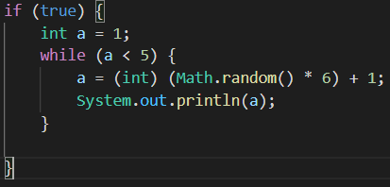
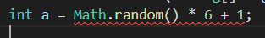
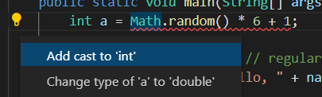
VS Code – Syntax highlighting and error management
Different types of code elements are marked by different colors:
Errors are marked by a red line:
Hovering the mouse over the text will show an explanation for the error
Pressing the lightbulb at the beginning of the line (if it exists) will offer a tip to solve the error
‹#›
Notes:
Try and learn and understand the mistake before and the reason behind it before fixing it.

